Slide 1
JSP Standard Tag Library
Presented by : Asfiya Khan ( Sr. Technical Trainer)

Slide 2
Agenda
JSTL Introduction
Custom JSTL tags

Slide 3
Why JSTL?
What if we really want is to print a property of a property??? For e.g. What if we want to print the name of Person’s dog??
Using scripting
<html>
<body>
<%=((foo.Person) request.getAttribute(“person”)).getDog().getName() %>
<body>
</html>

Slide 4
Why JSTL?
Using standard actions (if scripting is banned)
<html>
<body>
<jsp:useBean id=“person” class=“foo.Person” scope=“request” />
Dog name is <jsp:getProperty name=“person” property=“dog” />
<body>
</html> O/p in browser window: Dog name is foo.Dog@228994
The <jsp:getProperty> lets you access the properties of the bean attribute.
There is no capability for nested properties,
( a property of a property)

Slide 5
JSTL
JSTL Core Tags: JSTL Core tags provide support for iteration, conditional logic, catch exception, url, forward or redirect response etc. To use JSTL core tags, we should include it in the JSP page.
JSTL Formatting and Localization Tags: JSTL Formatting tags are provided for formatting of Numbers, Dates and i18n support through locales and resource bundles.
JSTL SQL Tags: JSTL SQL Tags provide support for interaction with relational databases such as Oracle, MySQL etc. Using JSTL SQL tags we can run database queries.
JSTL XML Tags: JSTL XML tags are used to work with XML documents such as parsing XML, transforming XML data and XPath expressions evaluation.
JSTL Functions Tags: JSTL tags provide a number of functions that we can use to perform common operation, most of them are for String manipulation such as String Concatenation, Split String etc.

Slide 6
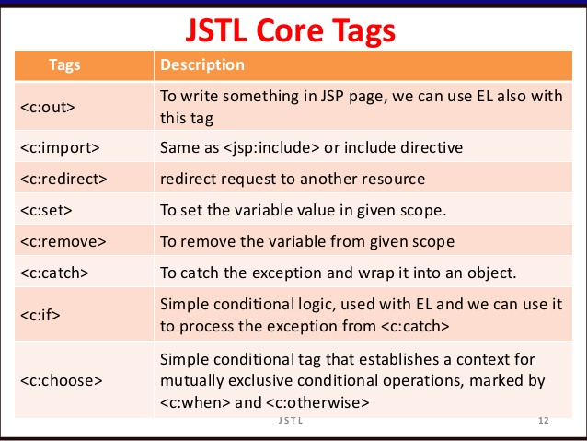
JSTL Core Tags

Slide 7
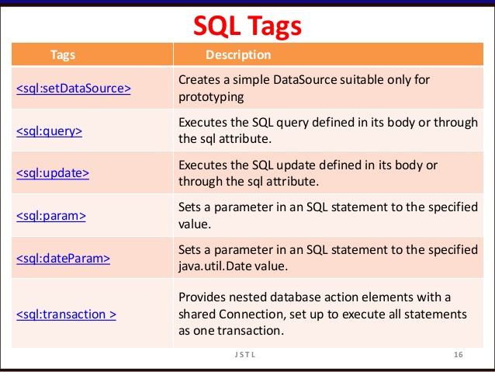
JSTL SQL Tags

Slide 8
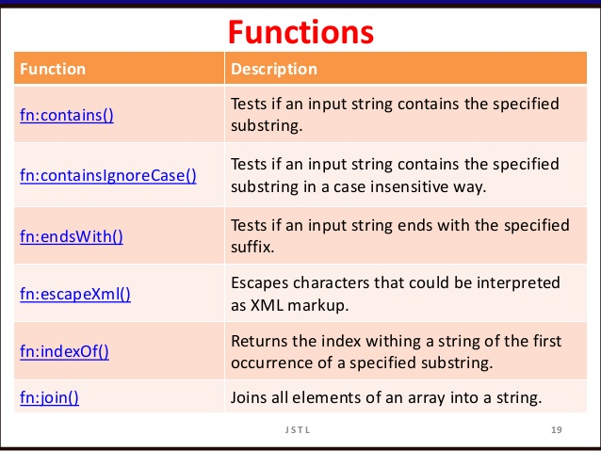
JSTL Functions Tags

Slide 9
<fmt:formatDate> : This tag is used to format date and time according to the user supplied style and format.
Attributes of the tag <fmt:formatDate>
value | supplied date and time to be formatted.
type | specifies that time or date or both date and time to be formatted of given date/time.
dateStyle | predefined styles to represent date. For example- default, short, long, full etc
timeStyle | predefined styles to represent time. For example- default, short, long, full etc
pattern | provided by user in what pattern user want to format. For example: dd-mm-yyyy
timeZone | in which time zone user want to represent date/time.
var | var is a variable that is used to store created data source.
Scope | Define the scope for declared variable like page or request or session or application.

Slide 10


Copyright © 2019 Cybage Software Pvt. Ltd. All Rights Reserved. Cybage Confidential.
www.cybage.com

Slide 11


Thank You!
11/21/2019
www.cybage.com
Copyright © 2019 Cybage Software Pvt. Ltd. All Rights Reserved. Cybage Confidential.

